Slide 1

Project Presentation FAKE NEWS DETECTION
Presented by:
Vikas Kumar Mishra

Slide 2
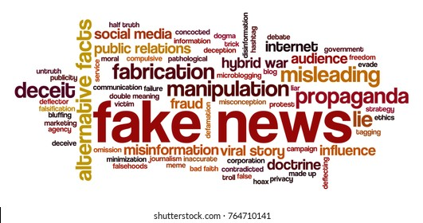

Slide 3
Introduction
Misinformation presents a huge challenge in online society. As a result, there have been many attempts to identify and classify misinformation. Specifically, in social networking sites, blogs, as well as online newspapers.
Since this is a very broad research area, in this article we’ll look at:
What is fake news and why you should care?
Manual vs automated fake news detection efforts.
A brief introduction to machine learning and deep learning techniques for fake news detection.
The goal is to give you a gentle introduction to automated fake news detection. This should hopefully challenge you to join the fight.

Slide 4
What is Fake News?
Fake news refers to information content that is false, misleading or whose source cannot be verified. This content may be generated to intentionally damage reputations, deceive, or gain attention. The term rose to popularity during the 2016 US Presidential Elections. It was reported that fake news likely influenced the results of the elections.

Slide 5
Various types of fake news include::
Clickbait. Often eye-catching content captures readers at the expense of being factual.
Satire/parody. This type of content is considered to be fun and humorous and thus considered to be entertaining, yet some readers may interpret the content as fact.
Propaganda. This is content meant to mislead and influence the reader.
Biased/partisan/hyper-partisan. Oftentimes this is biased political content claiming to be impartial.
Unreliable news. Journalists may publish news whose sources are unverified, or without carrying out any form of fact-checking themselves.

Slide 6
How Fake News Work
In today’s world, it is normal to receive news from online sources like social media. News is often subjective to readers. We often choose to ingest content that appeals to the different emotions we have. So, considering this, the information that gets the most reach may not be real or accurate news. Additionally, real news may be twisted in transmission. A reader may end up with different versions of the same news. This may lead to information overload.

Slide 7
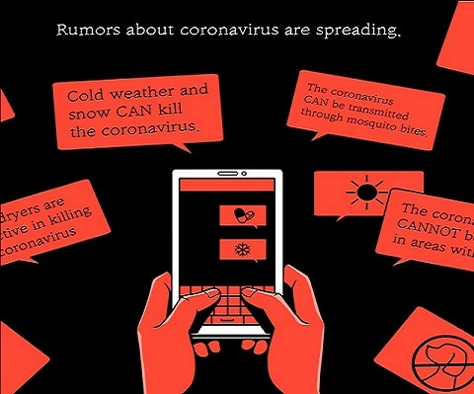
Why You Should Care

Slide 8
Why You Should Care
At a time when the globe is defined by a pandemic, public health depends on reliable information. Yet we stare down the barrel of an infodemic. An infodemic is the combination of the word information and epidemic. It is an excessive amount of information about a problem that makes the solution more difficult. It also defines a wide and rapid spread of misinformation.
This means that our individual health is a collective responsibility. It is tied to the behaviour of other people since news influences the behaviour of the audience. The World Health Organization has highlighted the dangers of a COVID-19-driven infodemic. It presents as much danger as the virus itself. According to WHO, fake news spreads faster and more easily than the virus.

Slide 9
Examples of challenges of such an infodemic include:
Promoting and selling fake coronavirus cures.
Spreading myths and rumors about the nature and spread of the virus.
Conspiracy theories about the origin and intention of the virus.
Encouraging unfounded remedies. Some touted remedies are harmless, others are comical, while others can be quite hazardous.

Slide 10
What’s being done to combat fake news
Companies like Facebook, Twitter, TikTok, Google, Pinterest, Tencent, YouTube, and others are working with WHO to mitigate the spread of rumors. Their efforts are geared at filtering out content that is a danger to public health. There are ways to contribute to this fight. But first, we need to understand the types of fake news detection being used. We will look at it from the perspective of being either manual or automatic.

Slide 11
Manual Fake News Detection
Manual fake news detection often involves all the techniques and procedures a person can use to verify the news. It could involve visiting fact-checking sites. It could be crowdsourcing real news to compare with unverified news. But, the amount of data generated online daily is overwhelming. Also noting how fast information spreads online, manual fact-checking quickly becomes ineffective. Manual fact-checking struggles to scale with the volume of data generated. Therefore, highlighting the reason behind the creation of automated fake news detection.

Slide 12
Text Collection
The collection process is carried out by referring to Kaggle ISOT Fake news datasets.
It is made up of approximately 44898 news records.
The true news data set is made of 21417 data and the fake news data set is made of 23481 data.

Slide 13
Automated Fake News Detection
Automated detection systems provide value in terms of automation and scalability. There are various techniques and approaches implemented in fake news detection research. And it is worth noting that these approaches often overlap depending on perspective.
These two approaches focus on the methods used, as opposed to the content being analyzed. They may also both involve Natural Language Processing (NLP) in their methodology.
Natural Language Processing enables computers to understand natural/human language and respond appropriately. Hence, there are two aspects involved:
Natural Language Understanding
Natural Language Generation

Slide 14
The two approaches to fake news detection are:
Machine Learning approach
Deep Learning approach

Slide 15
Machine Learning Approach
Machine learning refers to giving computers the ability to learn without explicitly being programmed. A machine learning approach uses machine learning algorithms to detect misinformation. Examples of these algorithms include:
Naïve Bayes: uses probabilistic approaches based on Bayes theorem. This algorithm is often used for text classification.
Decision Tree: a supervised learning algorithm that has a tree-like flow. It helps in decision-making. A useful algorithm for both classification and regression tasks.
Random forest: simply a combination of decision trees.
Logistic Regression: contrary to the name, it is a classification algorithm used to estimate discrete values.
K-nearest-neighbor: a simple algorithm that is used for both classification and regression tasks. Though it is more widely used for classification problems.

Slide 16
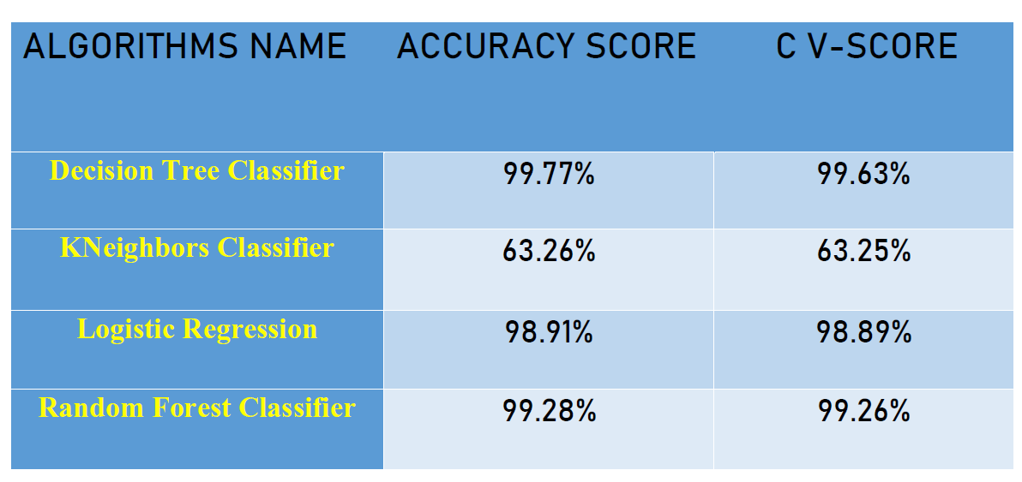
Result and Analysis

Slide 17
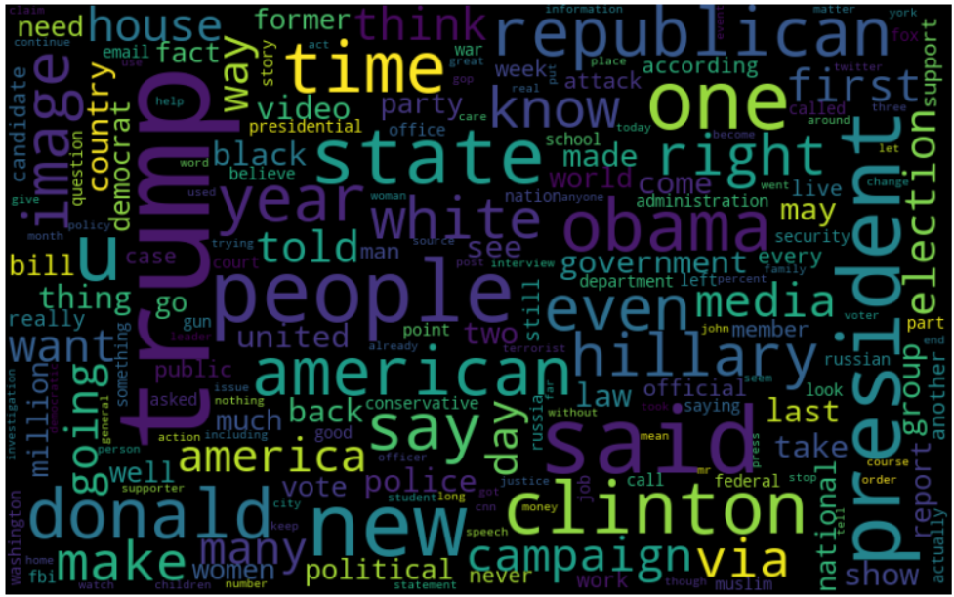
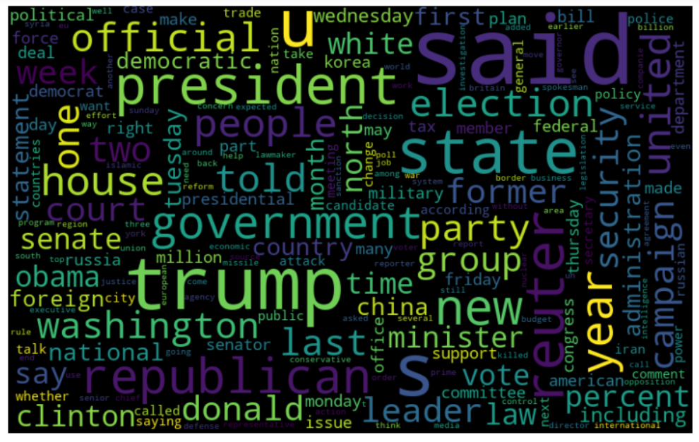
Implementation and Results
Word cloud images of fake news
Word cloud images of true news

Slide 18
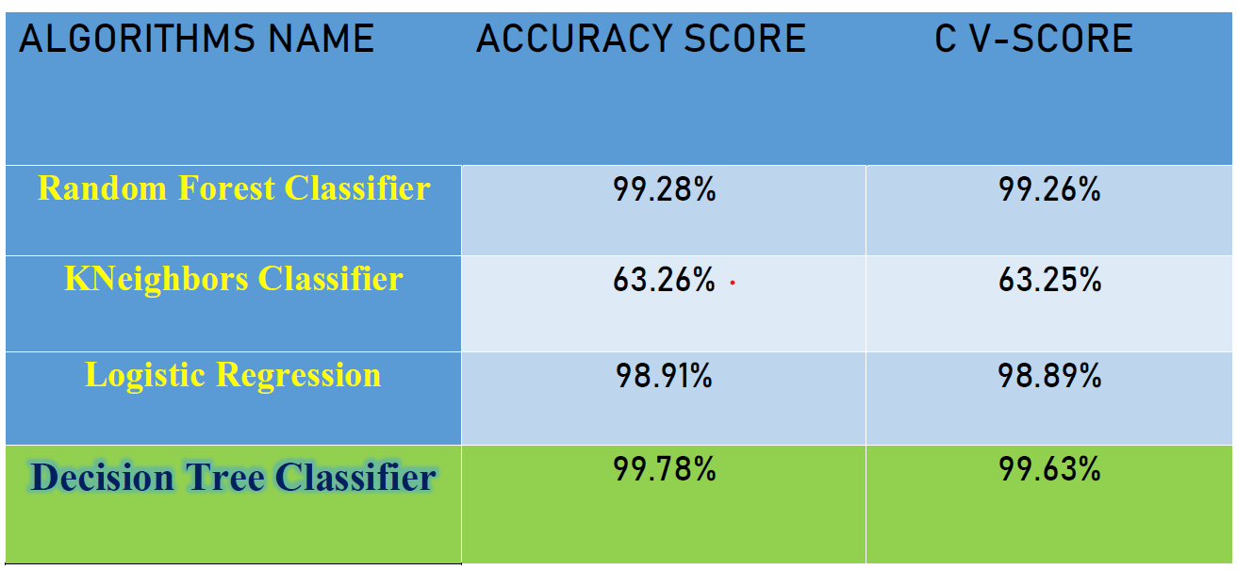
Conclusion
Fake news research has never been more important than it is now. Especially during a time when the world is fighting a pandemic. The approaches explored in this article only scratch the surface. There are so many more approaches and criteria for fake news detection. Datasets also impact the accuracy of fake news detection tasks.
Their quality and quantity are impactful. It is also worth noting that, as much as our focus is on automated approaches, the human element is key to this fight. A combination of human and automated approaches gives rise to a hybrid approach.

Slide 19
THANK YOU
SUBMITTED BY: VIKAS KUMAR MISHRA
BATCH: INTERNSHIP 32,
ID: 44

